Slide 1
Billiards Simulation
P76044025 黃粲富
P76044059 張傑程
P76044449 林意瑄
P76044481 吳邦宇

Slide 2
Outline
Introduction
Physical System
Application-1
Application-2
Conclusion

Slide 3
Outline
Introduction
Physical System
Application-1
Application-2
Conclusion

Slide 4
Introduction
Goal
Create a pool ball games simulator
Using this simulator to do some application, such as searching best angle / force

Slide 5
Introduction
Environment
Unity Engine
C# programming language

Slide 6
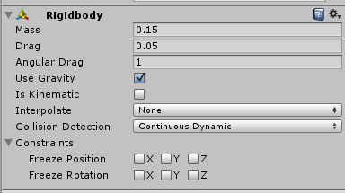
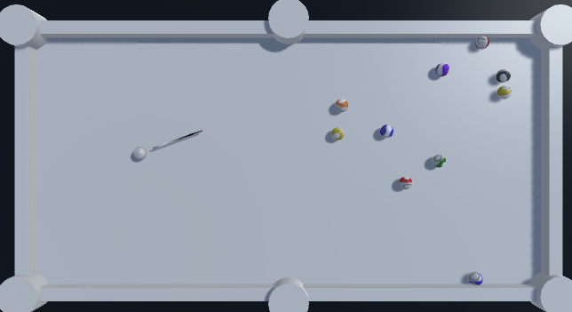
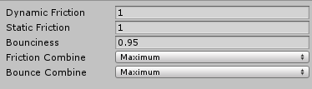
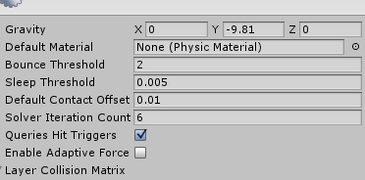
Introduction
Unity built-in physical system

Slide 7
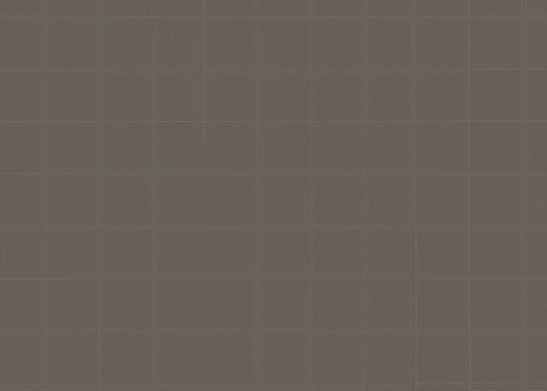
Introduction
Simulator based on Unity physical system

Slide 8
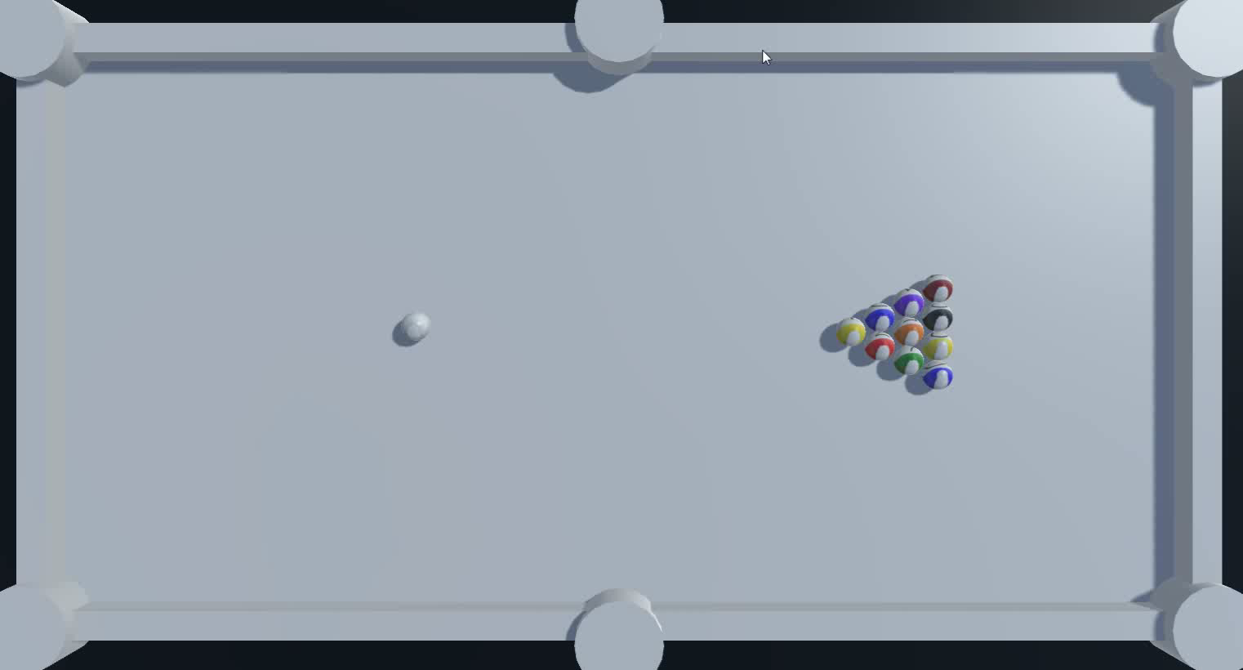
Introduction
Simulator based on our physical system

Slide 9
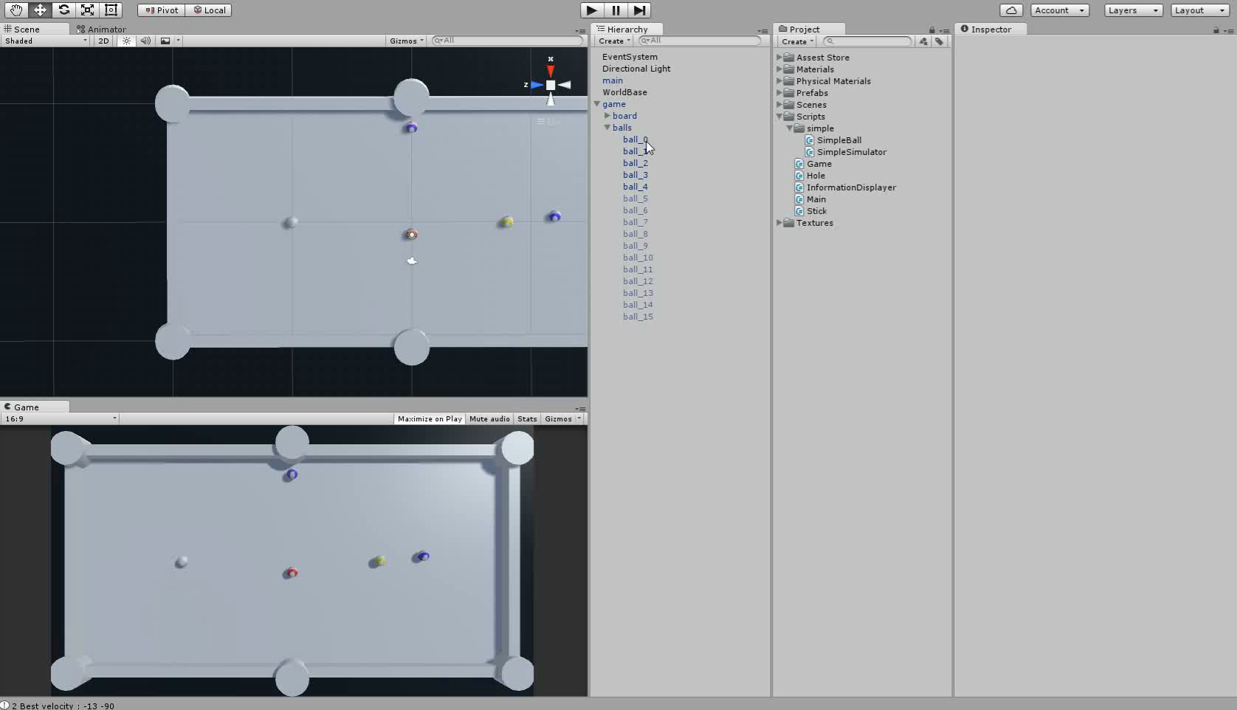
Introduction
Application

Slide 10
Outline
Introduction
Physical System
Application-1
Application-2
Conclusion

Slide 11
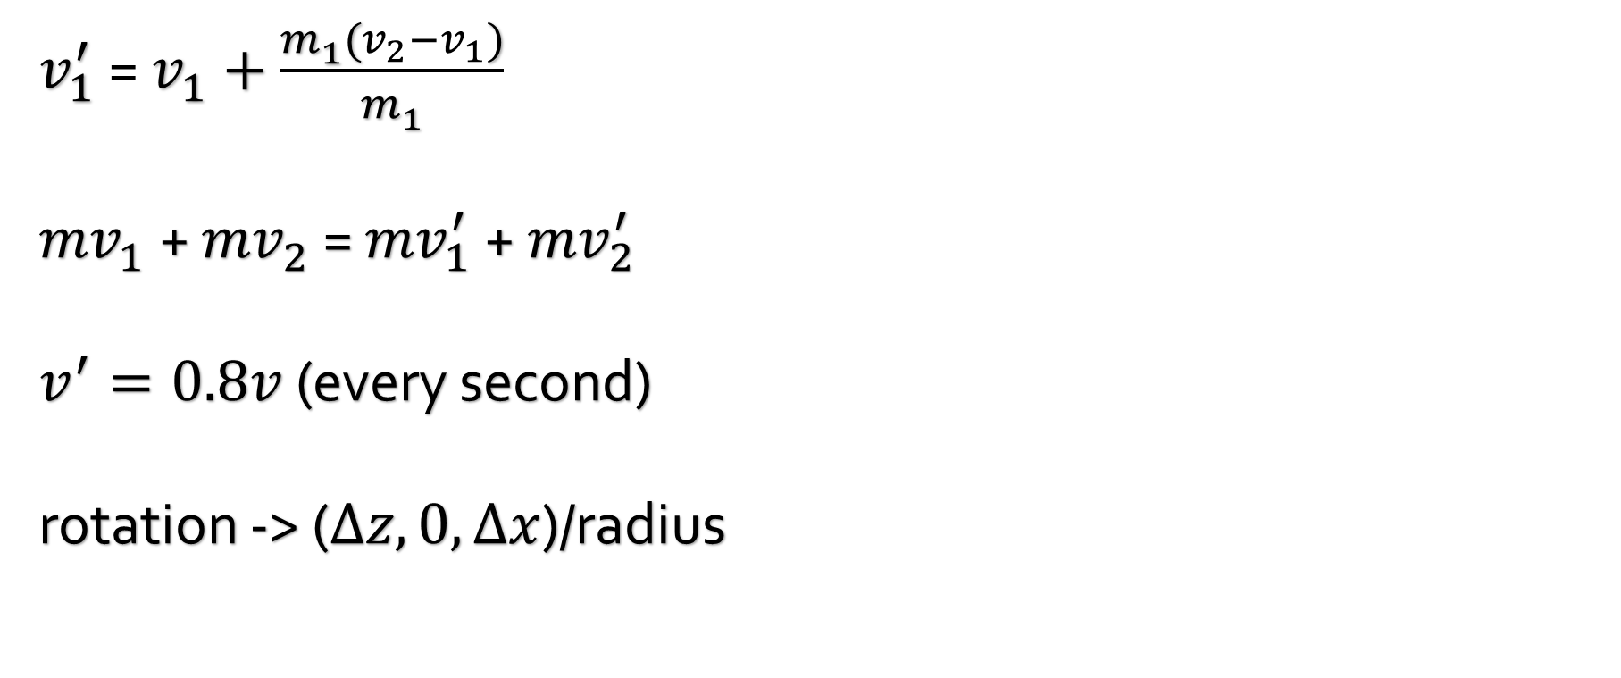
Physical System
$v_{1}^{′}$ = $v_{1}^{ }+\frac{m_{1}^{ }({v_{2}−v}_{1})}{m_{1}^{ }}$
${mv}_{1}^{ }$+ ${mv}_{2}^{ }$ = ${mv}_{1}^{′}$ + ${mv}_{2}^{′}$
$v^{′}={0.8v}^{ }$(every second)
rotation -> ($∆z, 0, ∆x$)/radius

Slide 12
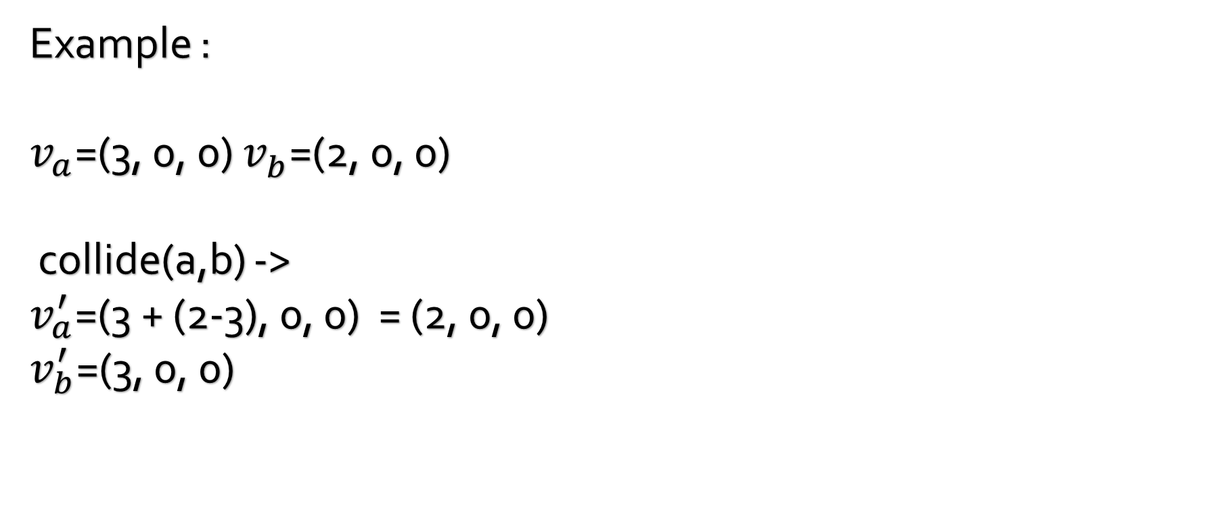
Physical System
Example :
$v_{a}^{ }$=(3, 0, 0) $v_{b}^{ }$=(2, 0, 0)
collide(a,b) ->
$v_{a}^{′}$=(3 + (2-3), 0, 0) = (2, 0, 0)
$v_{b}^{′}$=(3, 0, 0)

Slide 13
Thank you for your attention
Reference
Strategic play for a pool-playing robot
T Nierhoff, K Heunisch, S Hirche - Advanced Robotics and its …, 2012 - ieeexplore.ieee.org
Object-oriented Simulation of Pool Ball Motion
AP Goldberg - 1987 - UCLA, Computer Science …
Realistic Billiards Simulation with Variable Time-Step
L Anderson

